Slide 1
Updating a Product

Slide 2
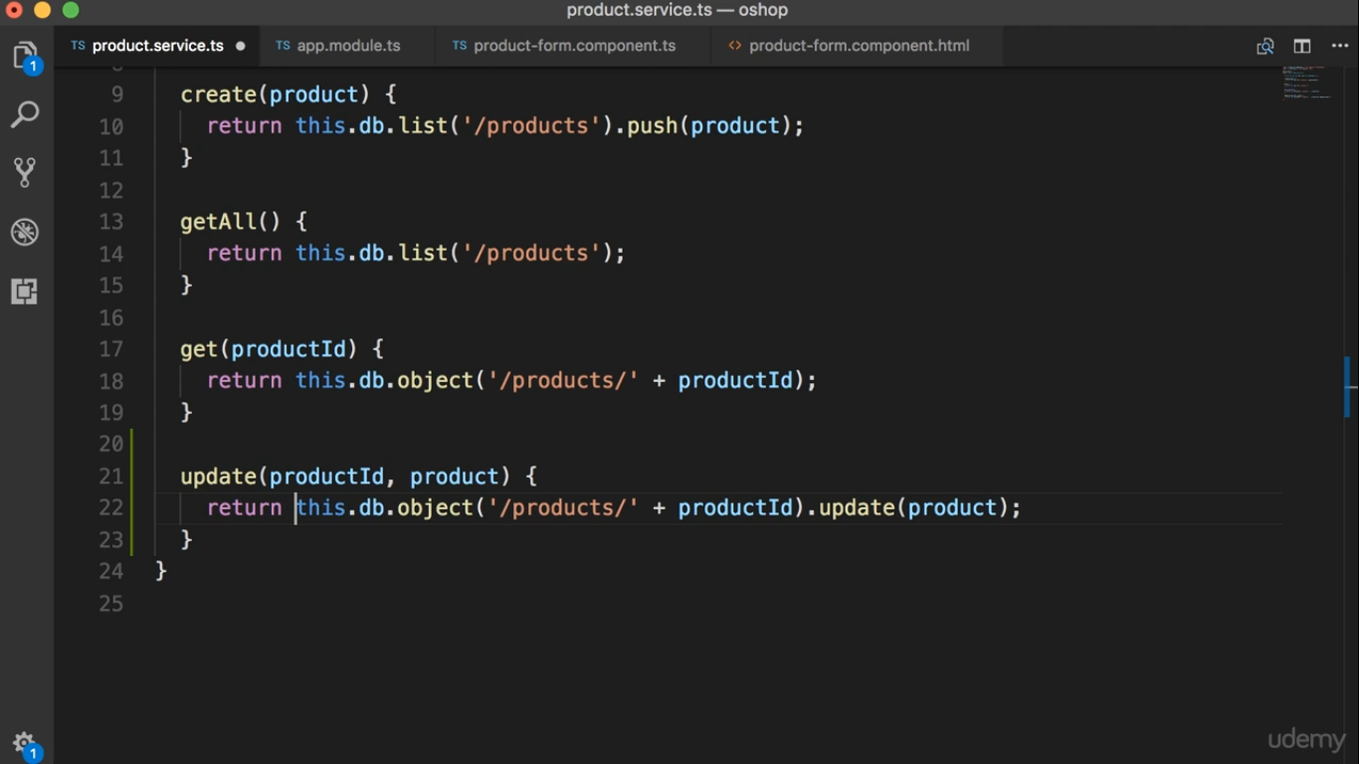

Slide 3
